Slide 1

HR ANALYTIC DASHBOARD USING Power BI
Ahmed Hamdy

Slide 2


Data Description
Employee ID
Attrition
01
02
Business Travel
Age & Age Group
03
04
Unique identifier for each employee
Whether the employee has left the company (Yes/No)
Frequency of work-related travel
Employee’s age and categorized age group

Slide 3
Data Description
Department
Job Level & Job Role
05
06
Distance from Home
Education & Education Field
07
08
The department where the employee works
Position and role within the company
Distance between home and workplace
Employee’s education level and specialization

Slide 4
Data Description
Salary & Compensation
Work Environment Ratings
09
10
Years at Company & with Current Manager
11
Monthly income, salary bands, stock options
Job satisfaction, work-life balance, performance ratings
Experience in the company and under the current manager

Slide 5
Objective
Identify factors impacting employee retention

Slide 6
Analysis & Key Findings
📉 Employees with low job satisfaction are more likely to leave
⏳ Longer tenure with the current manager increases retention
💰 Higher salaries alone do not guarantee employee loyalty if job satisfaction is low
📈 Frequent business travel and long commuting distances increase the likelihood of attrition
📢 Understanding these factors helps organizations reduce attrition rates and improve work environments!

Slide 7
Recommendations & Conclusions
📢 How Can Companies Improve Employee Retention? ✔️ Enhance workplace culture and work-life balance ✔️ Invest in employee training and career development ✔️ Offer performance-based incentives instead of tenure-based raises ✔️ Reduce unnecessary business travel and support hybrid work models

Slide 8
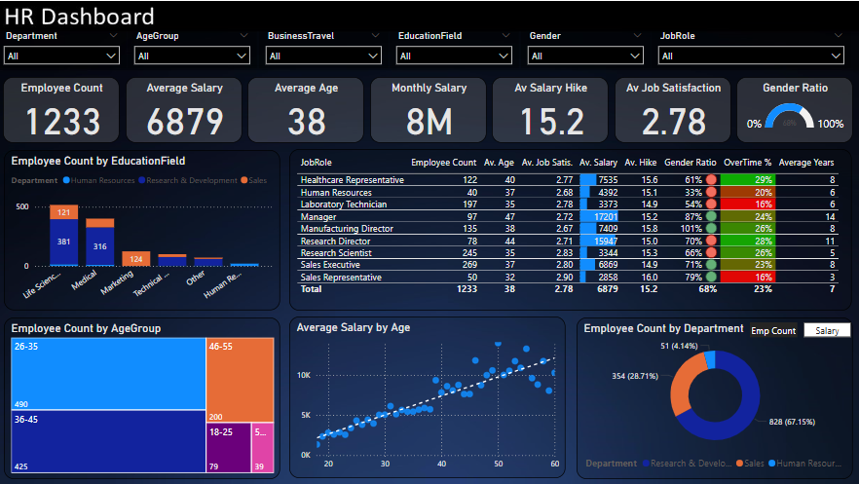
Our Dashboard
Company-Wide HR Analytics

Slide 10
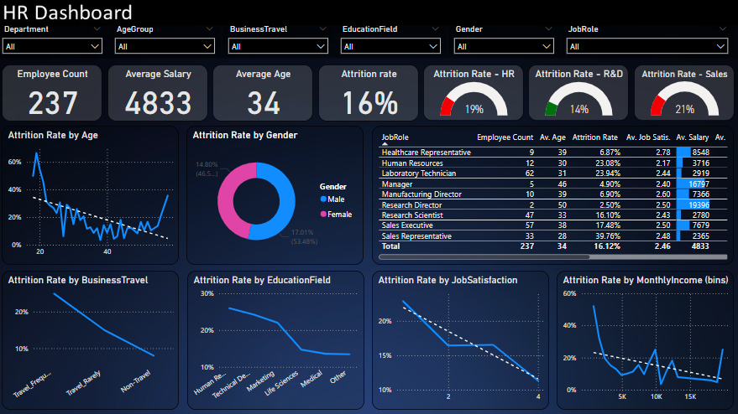
Our Dashboard
Employee Attrition Analysis

Slide 12
Thanks!
Does anyone have any questions?
+2010 9272 1167
Ahamdy438@gmail.com

